Slide 1
Election Data Analysis using Tableau
CMPE 274 Project under Prof. Weider Yu
Ajinkya Thakare (012436489)
Akshay Jaiswal (013774137)
Akshay Pagar (013717379)
Janhavi Dahihande (013732030)
Koushik Kumar Kamala (013766571)
Sai Harshith Reddy (013533026)
Daniel Sampreeth Eadara(013702988)
Madhusudhan Shagam (013707187)

Slide 2
Problem Statement
Elections are imperative to democracy
Low voter turnouts impair the objectives of election
Let citizens make a contribution in the democratic governance
Let citizens voice out opinions
Waste government resources on elections
Important to understand the reasons for low voter turnouts
Problem Statement:
Use Business Intelligence and Analytical tools to visualize and understand data
Derive possible voter turnout patterns that help understand low turnout reasons
Suggest plausible solutions that may help fix the problem areas
Reduce unnecessary government spending

Slide 3
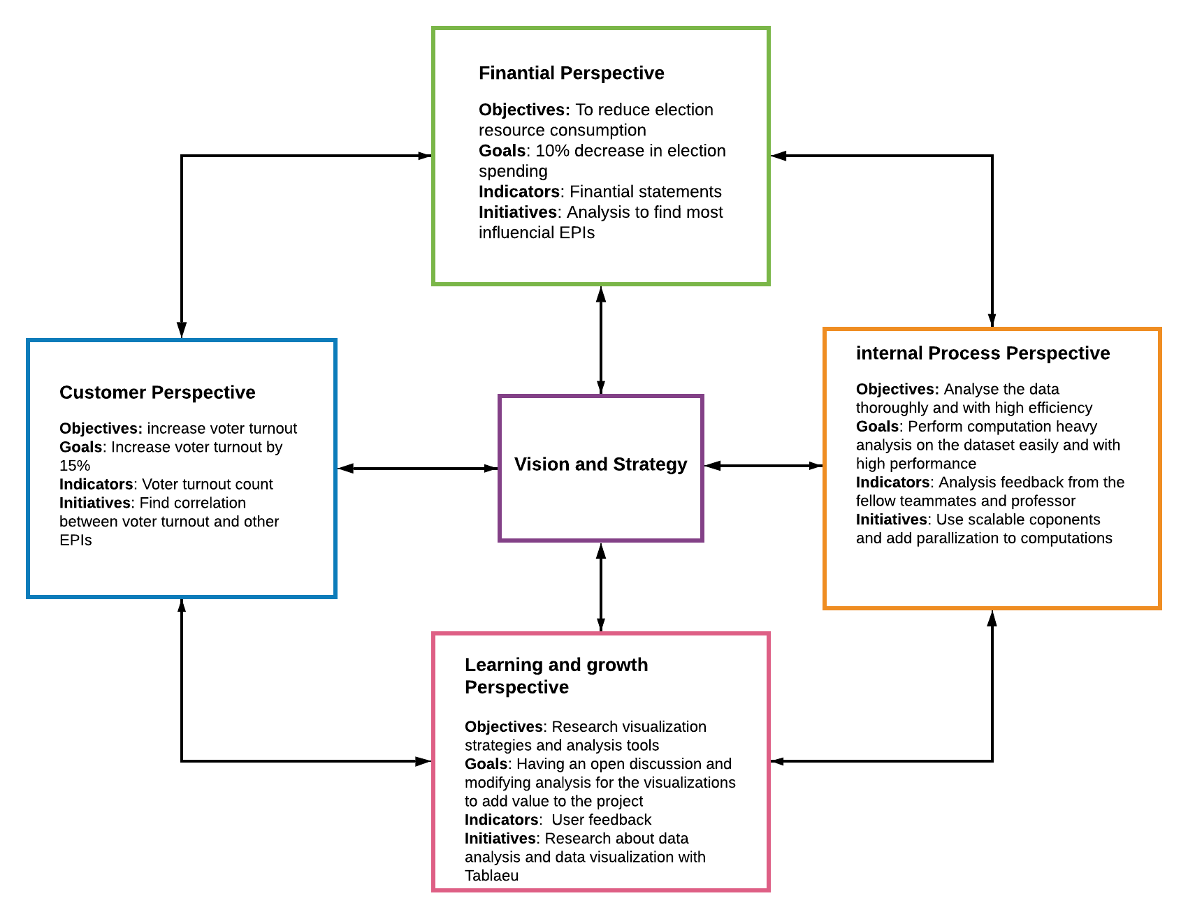
BPM Scorecard

Slide 4
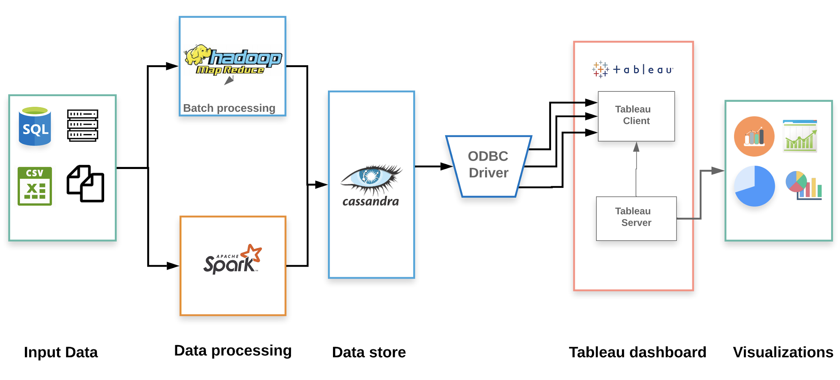
System Architecture

Slide 5
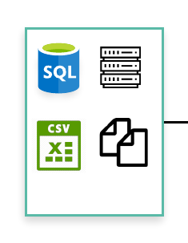
Input Data
Input data includes simple flat files
MIT Election Data + Science Lab
https://github.com/MEDSL/election-performance-index
Contains various key point indices
Number of records - 25000
Number of columns - 25
Kaggle 2016 US election dataset (consists of democratic data on counties from the US census)
https://www.kaggle.com/benhamner/2016-us-election
Number of columns - 54

Slide 6
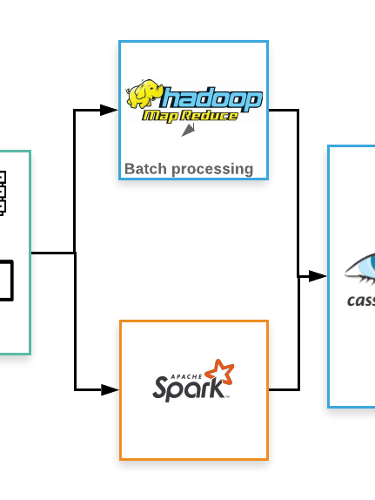
Data Processing
Anticipating queries is an important part of Cassandra’s storage model.
Spark performs various operations using Hadoop’s map-reduce to generate data to be stored in the Cassandra database.

Slide 7
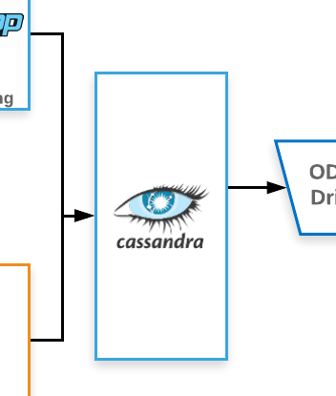
Data Store
We have used Cassandra as our data store.
Cassandra is a NoSQL column-oriented database.
It doesn’t have any single point of failure and every node in the cluster is identical.
We chose Cassandra as our data store because it outperforms the other NoSQL alternatives without compromising performance

Slide 8
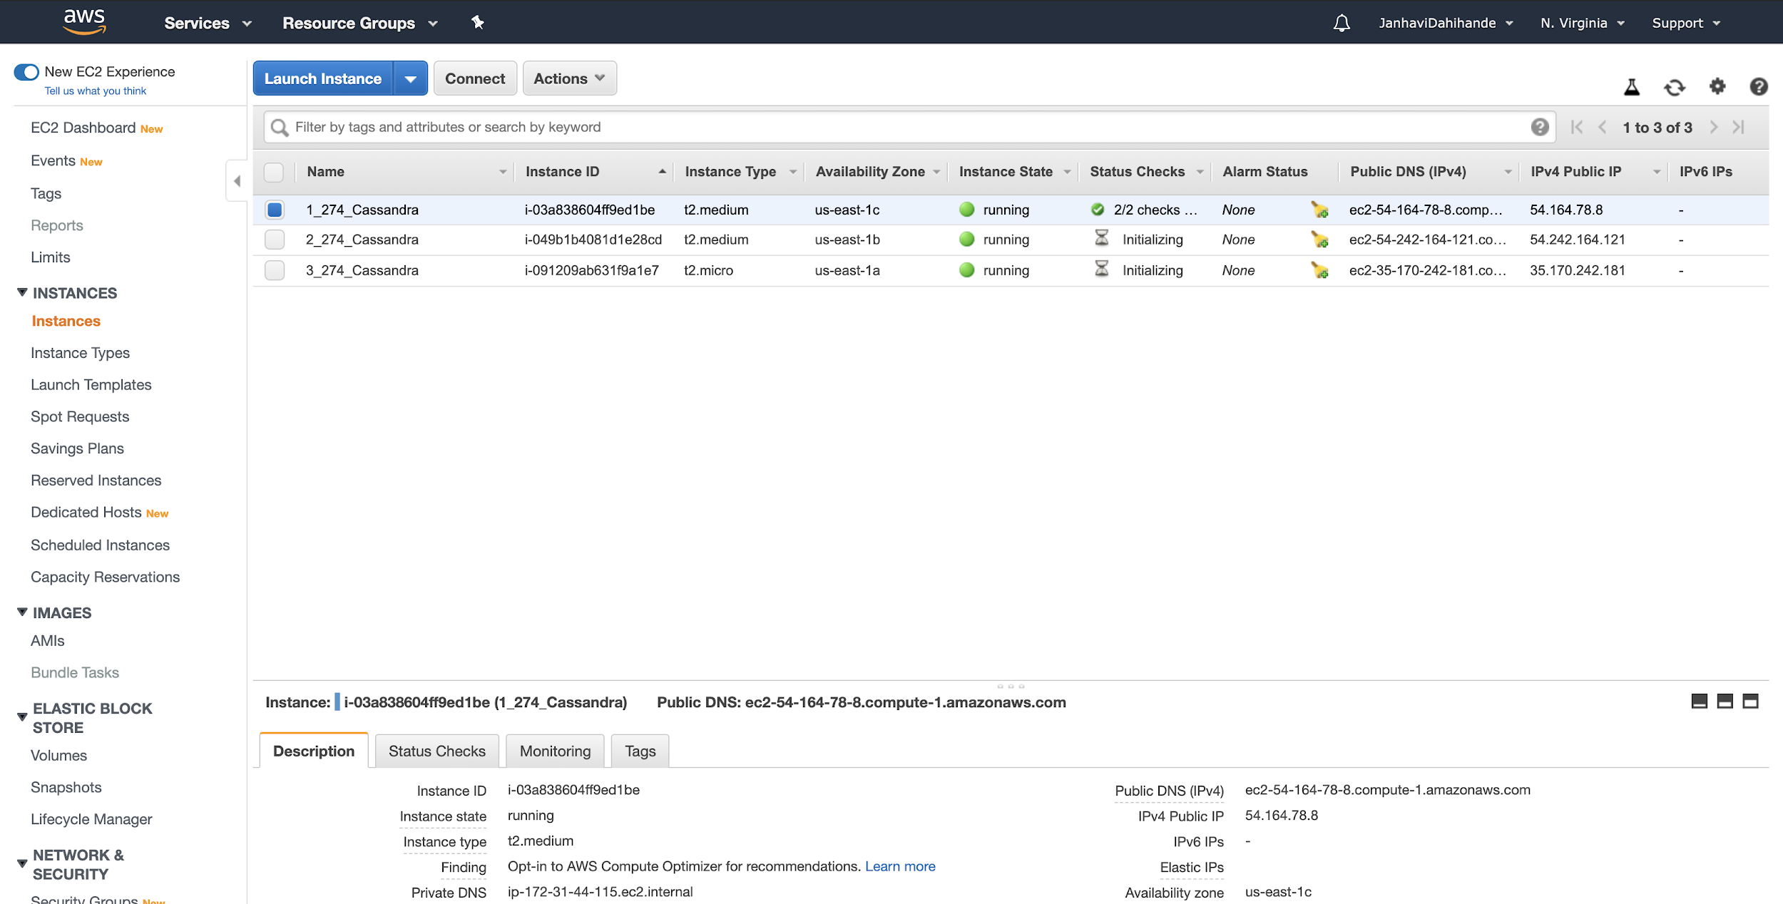
Cassandra Cluster on EC2

Slide 9
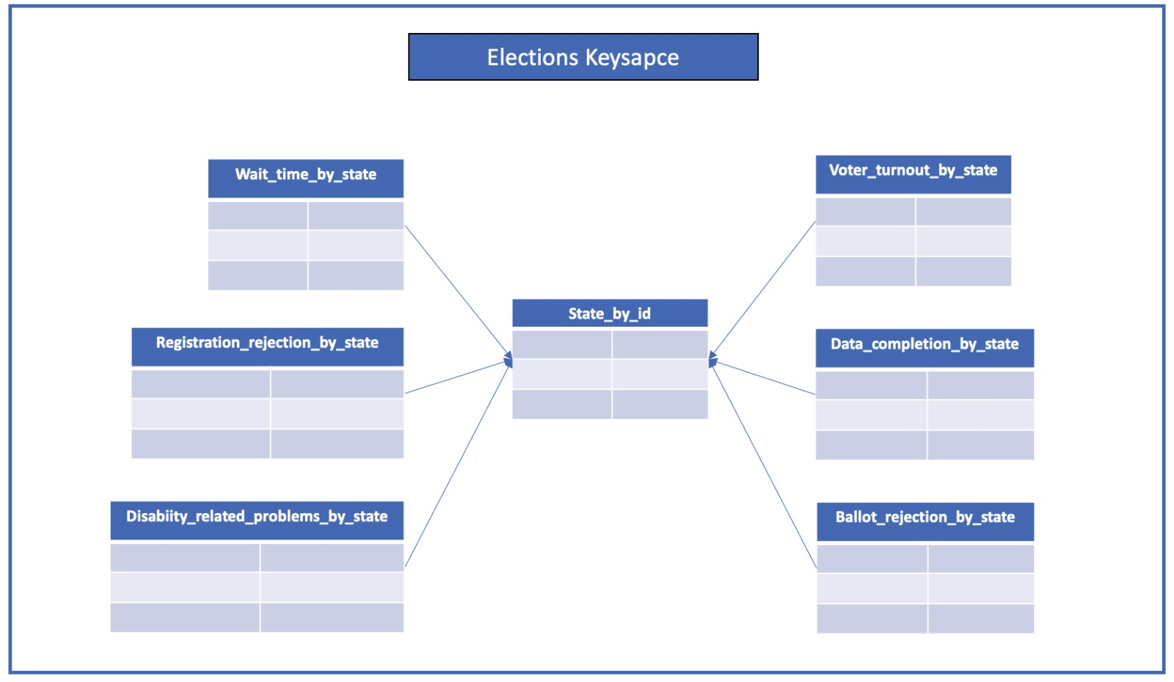
Database Design
Column families
Wait time by state
Voter turnout by state
Data completion by state
Ballot rejection by state
Disability related problems by state
Registration rejection by state

Slide 10
Cassandra Keyspace
Focuses on data replication on nodes
Every node in our cluster contains a keyspace
Elections keyspace consists of different tables satisfying a particular query
Query-focussed approach
Every key performance indicator will have a different column-family as we can see in the database design

Slide 11
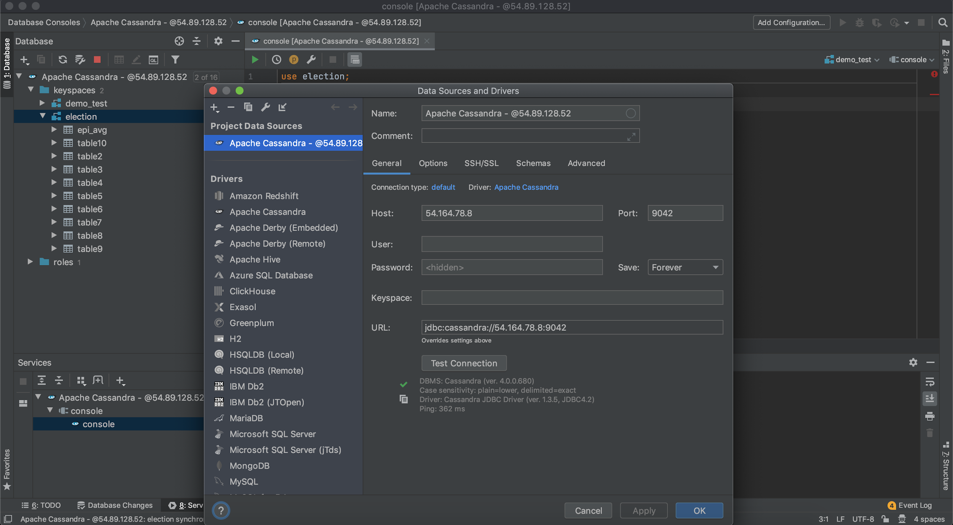
DataGrip

Slide 12
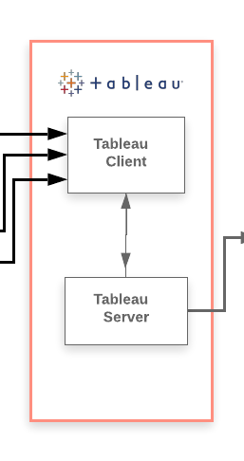
Tableau Dashboard
Consolidated display of many worksheets
For comparing and monitoring various data simultaneously
Data stored in Cassandra can be accessed using ODBC drivers
Provide various Visualizations using this data

Slide 13
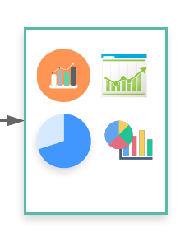
Visualizations
Visualizations should tell a story
Use graphs
Various graphs in our project:
Voter turnout trends
Ballot rejection, etc

Slide 14
Data Analysis Approach
Relationship between disability vs turnout group by state
Registration Rejection vs Turnout
Wait time vs Turnout
Non-Voter Illness Problems vs Turnout

Slide 15
Visualization Design Indicators
Disability-or Illness-related Voting Problems
Online Registration Available
Residual Vote Rate
Turnout
Voter Registration Rate and more
Notes:
Action items:

Slide 16
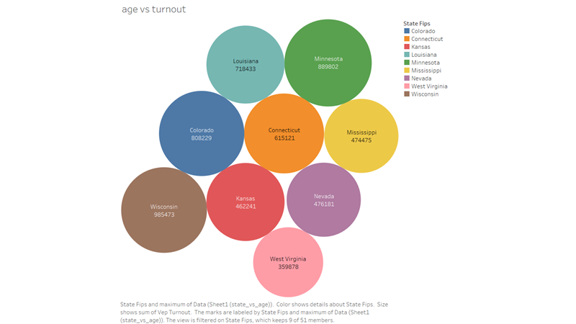
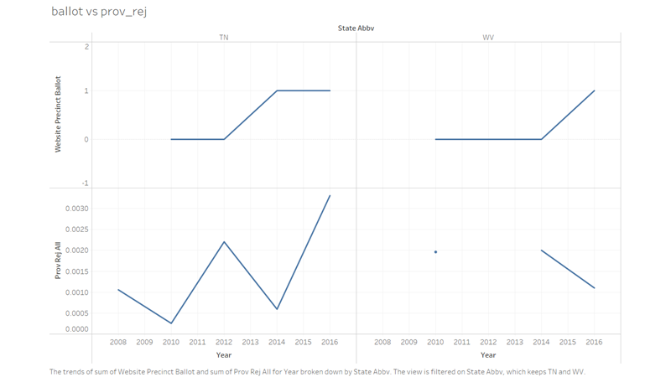
Sample Visualizations

Slide 17
Perspectives | Strategic Objectives |  | Measures / Key Performance Indicators | Targets | Initiatives | Status
 | Category | Objective
Financial | Database | Find free to use datasets and database | No payment for the use of dataset | Using datasets without having to pay the source or creator | Search for datasets and databases | 100%
 | Data Analysis | Find free to use data analysis tools | No payment for the use of tools | Using tools for analysis without having to pay the source or creator | Search for analysis tools | 100%
 | Visualization | Find free to use data visualization tools | No payment for the use of tools | Using tools for visualization without having to pay the source or creator | Search for visualization tools | 100%
Customer | Database | Use datasets from legitimate, reputed and frequently updating sources | Rating for the references for this data and number of times it is updated every election cycle | Use a legitimate and highly reliable source of data which updates the data frequently | Verify source references and reputation | 100%
 |  | Use a database which is reliable, scalable and high performing | Database read/write times | Perform frequent and heavy read/write tasks and get good performance | Perform tests on the database before finalizing | 100%
 | Data Analysis | Perform thorough analysis of the problem of low voter turnout | Correlation between the EPI indicators | Get meaningful insights from the dataset | Exploratory data analysis | 100%
 | Visualization | Dashboard that provide all the results to the team and the customers at one glance | Readability and correlation of the EPIs | Showcase all the results of the analysis | Deciding right visualization components | 100%
Internal Business Process | Database | To be able to use the dataset and database easily and effectively | Ease of access to the dataset and databases | Use datasets to perform analysis | Make dataset and database easy to access by giving proper access to both | 100%
 | Data analysis | Analyzing any correlation between indicators | Correlation visualization | Analyzing any correlation between indicators | Analyzed statewise indicators distribution grouped by age | 100%
 |  | To be able to perform thorough analysis on the dataset with high efficiency | Analysis feedback from the fellow teammates and professor | Perform computation heavy analysis on the dataset easily and with high performance | Use scalable components and add parallelization to computations | 100%
 | Visualization | Make visualization results readily accessible in a shared location | Ease of access to the visualization | Easily navigable visualization dashboard | Prioritize the visualization results based on key performance indicators. | 100%
 |  | To be able to use visualization tools and features to effectively visualize results | Visually interpretable results | Easy to understand visualization | Strictly follow deadlines to not affect tasks that are dependent on visualization and related processes. | 100%
Learning and growth | Database | Finding reliable sources of data and research about various databases | Comparing databases for the same scenario | Find the best possible datasets and databases for the use case | Search on data.org and kaggle for datasets and read technical articles for right databases | 100%
 | Data Analysis | Sharing techniques and methodolgies related to project progress. | Analyzing any correlation between indicators | Analyze the voter's distribution based on voter registration for each state | Explore and compare various data analysis tools | 100%
 | Visualization | Research about data analysis and data visualization with tablaeu | Having an open discussion and modifying analysis for the visualizations to add value to the project | Having an open discussion and modifying analysis for the visualizations to add value to the project | Research about data analysis and data visualization with Tablaeu | 100%
 |  | Learning about the tablaeu environment setup | Proper install and usage | Use tablaeu to its full potential | 100% | 100%

Slide 18
Challenges and new learnings
Finding key performance indicators
Finding correlation between indicators
Performing computation heavy tasks on the dataset
Using cassandra with Apache PySpark and Hadoop

Slide 19
Demo

Slide 20
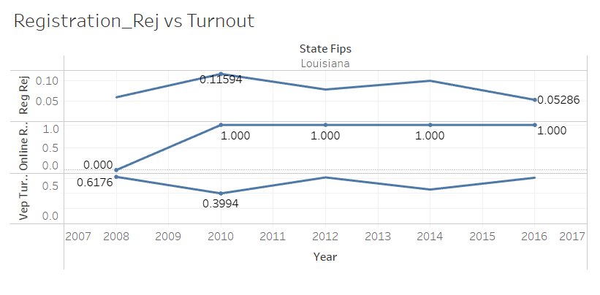
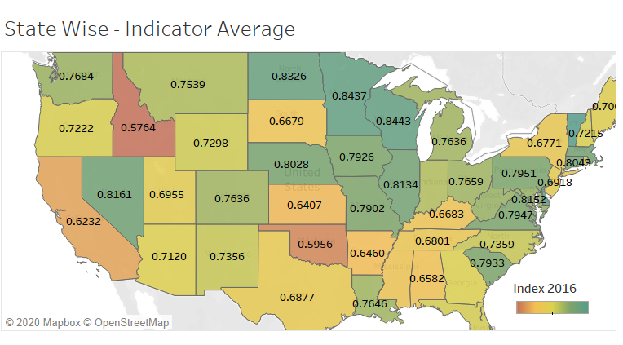

Slide 21
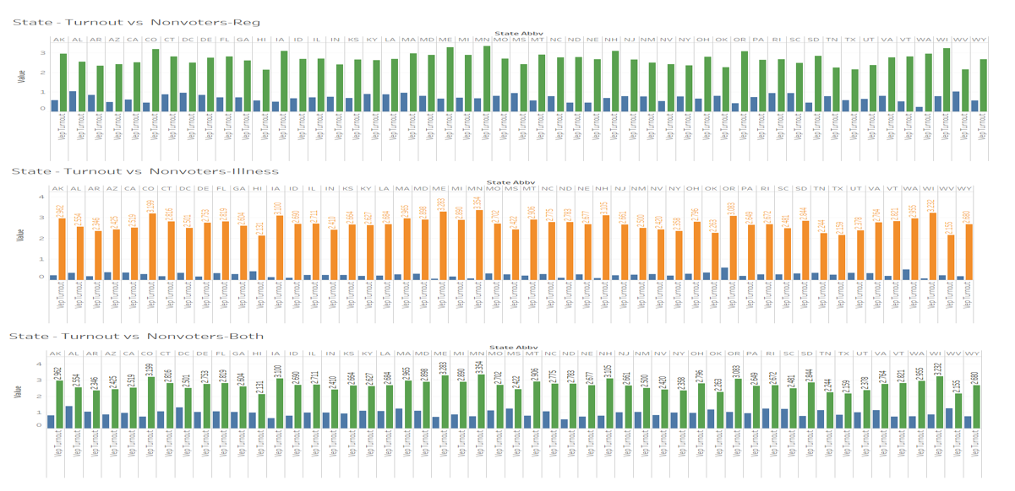

Slide 22
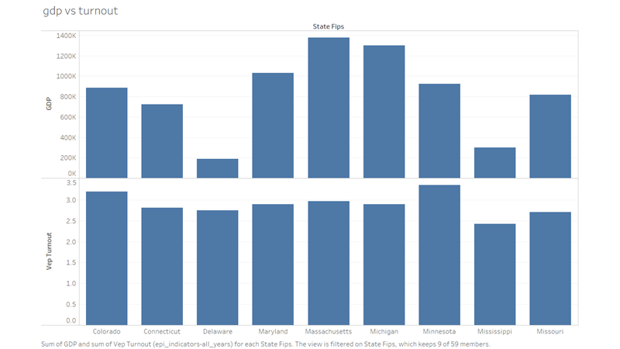

Slide 24
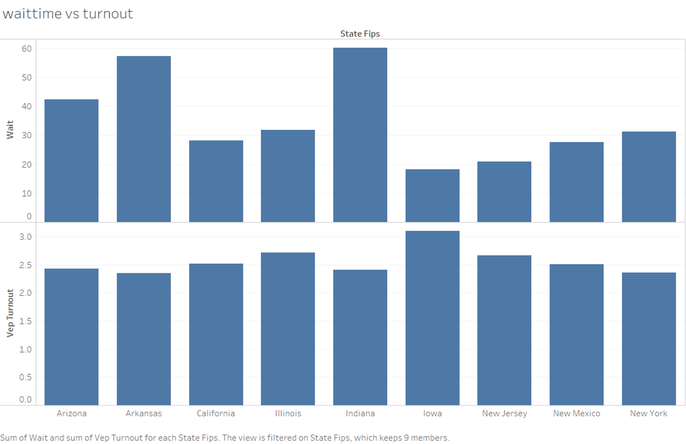

Slide 25
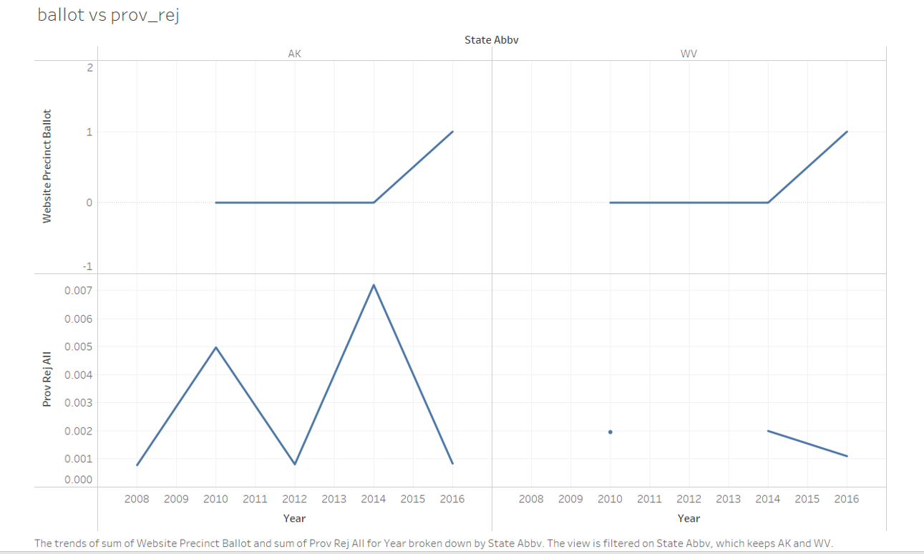

Slide 26
References
The Measure of American Elections. Eds. Barry C. Burden and Charles Stewart III (New York: Cambridge University Press, 2014)
Environmental Performance Index, http://epi.yale.edu.
The World Justice Project Rule of Law Index, http://worldjusticeproject.org/rule-of-law-index.
Government Accountability Office. Voters With Disabilities: Additional Monitoring of Polling Places Could Further Improve Accessibility. GAO-09-941 (September 2009), http://www.gao.gov/assets/300/296294.pdf.
U.S. Election Assistance Commission, Uniformed and Overseas Citizens Absentee Voting Act (2008 report), 10, http://www.eac.gov/assets/1/Page/2008%20Uniformed%20and%20Overseas% 20Citizens%20Absentee%20Voting%20Act%20Survey.pdf. U.S. Elections Assistance Commission, Uniformed and Overseas Citizens Absentee Voting Act (2010 report), 8, http://www.eac.gov/assets/1/Documents/EAC%202010%20UOCAVA%20Report_FINAL.pdf U.S. Election Assistance Commission, Uniformed and Overseas Citizens Absentee Voting Act (2012 report), 9, http://www.eac.gov/assets/1/Documents/508compliant_Main_91_p.pdf.

Slide 27

Thank You !

